Slide 1
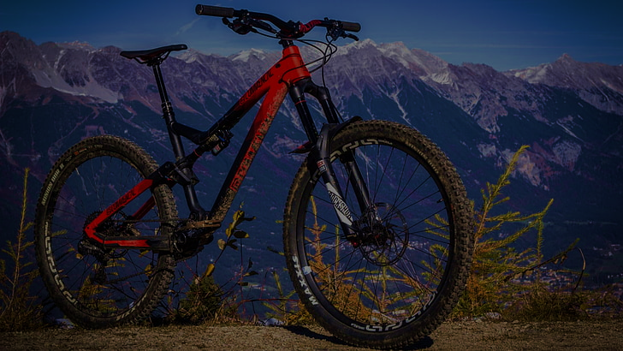

Dashboard
Bike Sales Analyzation
Power Point Presentation
Presented by:- Palash Kuche

Slide 2
Introduction:-
In this Presentation we are going to understand the revenue generated on bike commodities in 6 major countries:-
United States
Australia
United Kingdom
France
Canada
Germany

Slide 3
About Project:-
This project contains:-
Raw sales data of bikes along with clothing & accessories
Top sales on Products based on revenue & profits Generated
Sales Trendline in a quarterly basis from year 2011-2016
Top countries with amount of sales based on percentage
Sales Based on Product categories
Average Amount spent on products based on age groups

Slide 4
Problem Statements:-
Following are the Problem statements Data contains:-
What are the top sales based on countries?
How much amount was spent on clothing?
How much amount was spent on Equipments & Accessories?
How much profit generated?
Which year was best on a yearly basis?
Which age group bought most of the products?
Which product category was sold the most?
What country had the best sale & in what kind of products?
Which year had the best sale on a quarterly basis?
Which Product was sold the least?

Slide 5










Top Sales Based on Products

Slide 6


Sales Trendline on Quarterly Basis

Slide 7
Sales Based on Countries

Slide 9
Average Amount Spent Based on Age Group

Slide 10
Conclusion:-
Based on the analysis of data I hereby conclude that:-
Almost 48% of sales are coming from united states & Australia while comparing to the rest of the countries.
Age groups between 25-64 are the ones with the most sales

Slide 11
Next Step:-
Steps that could be Considered are as follows:-
Our Target Audience For Marketing Should be Young Adults & Adults as they are the ones with most Average Amounts Spent.
In Countries like Canada, Germany, UK, France, we should focus on Selling Products that are Mandatory based on their Environment like heavy Clothing, Strong Commodities based on their Atmosphere.
Focus on Working on Qualities of Commodities that are considered for Safety Purposes like Helmets, Strong Tyres. etc.

Slide 12
Thank You

